Slide 1
REGISTRATION FORM for student
FOLLOWING MEMBERS:
Chino ascedillas
Christian agripino
Ryan bautista
Justine rhey royo

Slide 2
FUNCTIONS:
ADD STUDENTS
UPDATE STUDENTS
ENROLLMENT FOR THE STUDENTS
SHOW THE LIST

Slide 3
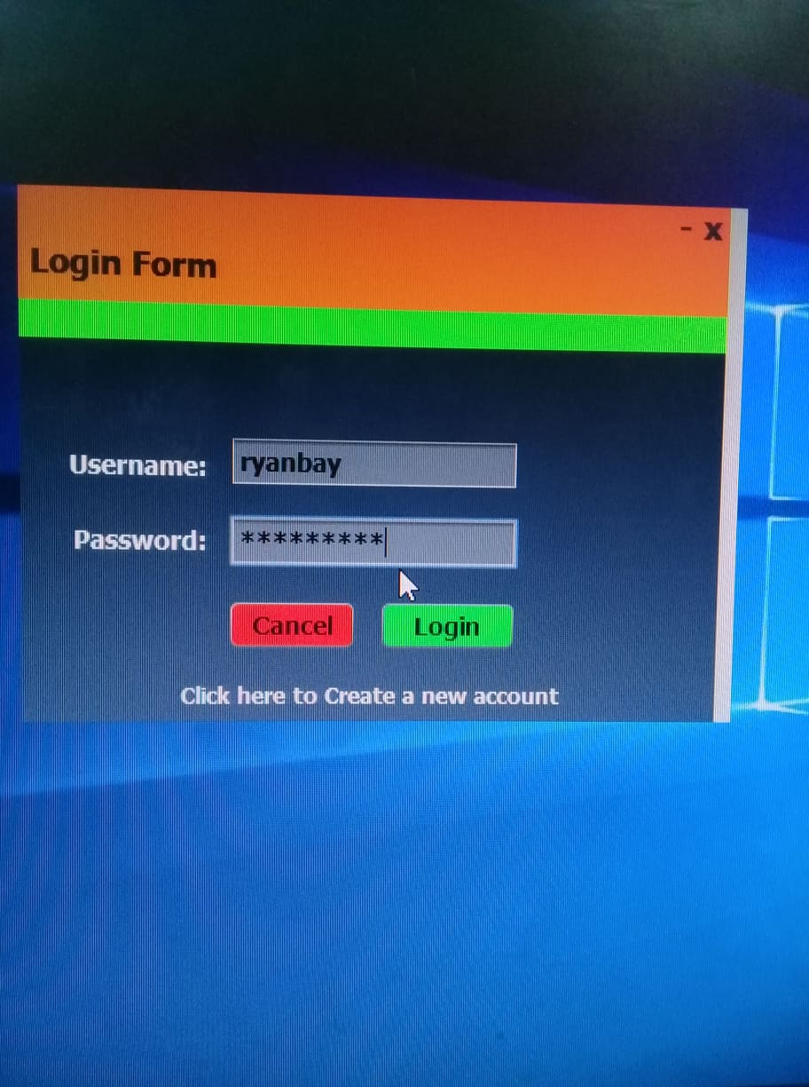

Slide 4
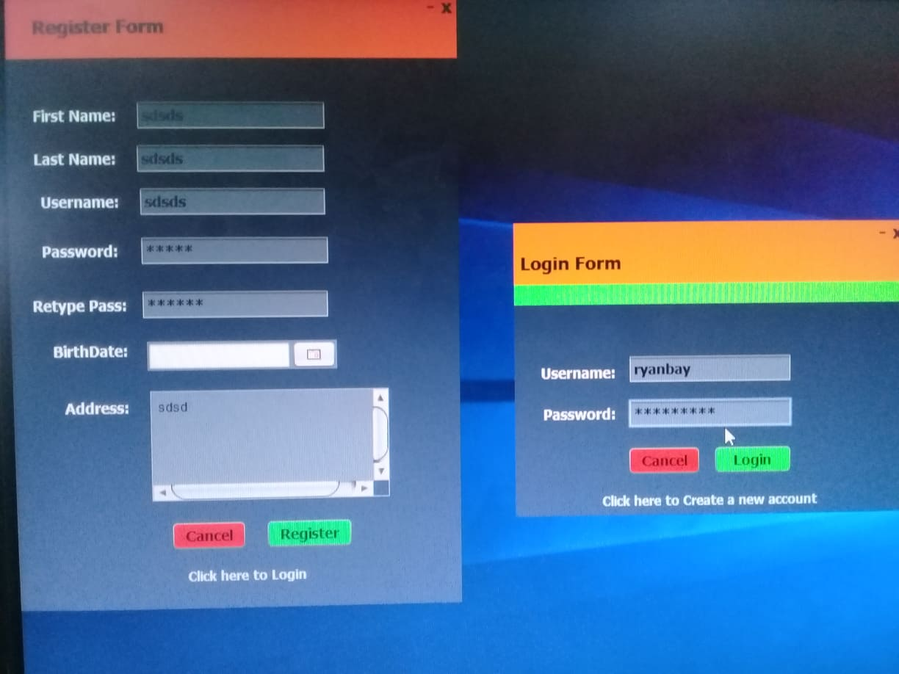

Slide 5
Go beyond learning graduate nami AS soon as possible ☺ ☺ ☺

Slide 6
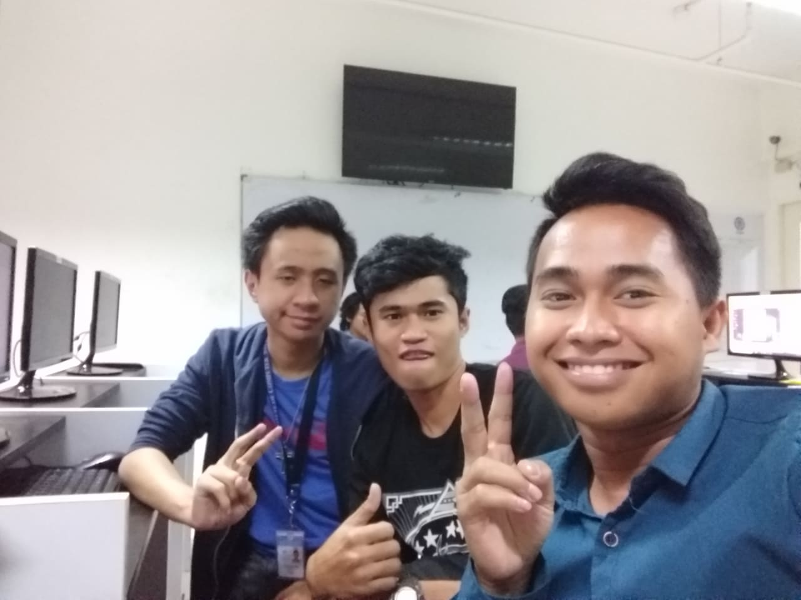
After coding:

